Slide 1



Projects and Laboratory on communication systems
Marco Chiavello s281692
Daniele Crimi s290164
Gianpietro Noto s281305
Academic Year 2021/2022

Slide 2
Inventory management system
Generic Database
To keep track of items
Three different System UI
◉Admin
◉Customer
◉User
e-motion

Slide 3

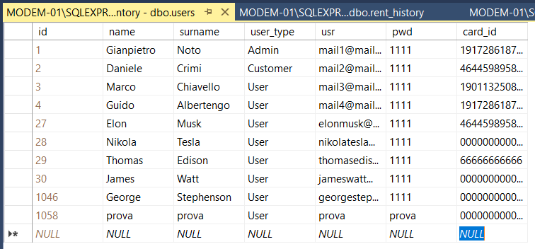
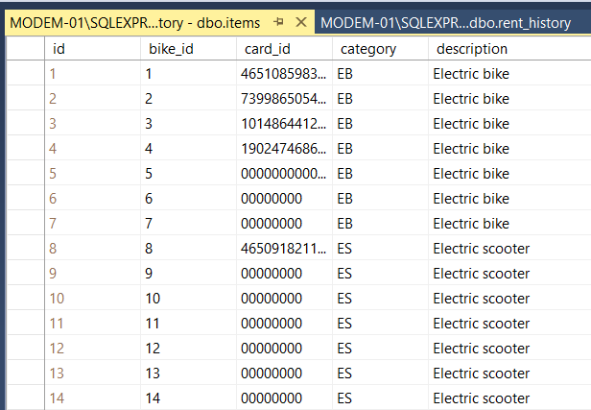
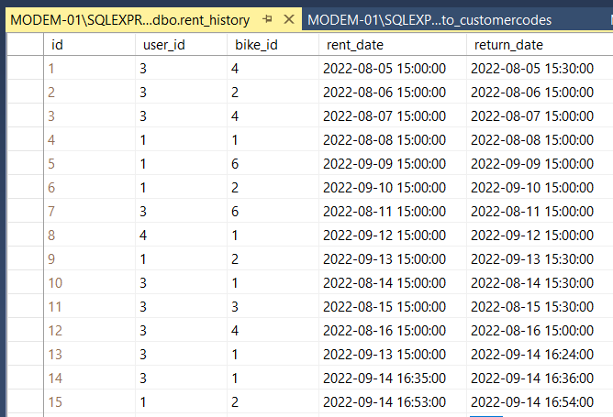
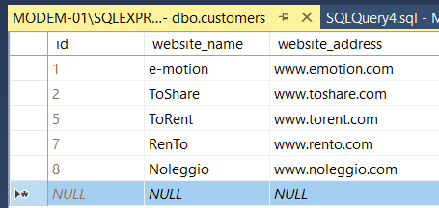

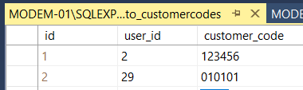
The customers table
The users table
The items table
Totems to customers table
Users to customers codes table
Rent history table
3

Slide 4
Database Access
----------------------------------------------------------
Web
UI
WEB
API
WEB
API
WEB
SERVER
Totem
UI
-------------------------------------
WEB
API
Smartphone
UI
----------------------------------------------------------
4

Slide 5


Flask & Flutter
The micro web framework written in Python
The open-source UI software created by Google
5

Slide 6
The Totem
First Configuration
📱
The totem is sent to the Customer
At start it is preconfigured in kiosk mode
It is required to insert a key6 pin sent to the customer at registration phase, in order to link the totem to the customer
The totem is ready to be used by Users or Customer
👤
The user’s interaction (totem UI for user)
The totem has an User UI dedicated to login, rent/return an item or performing a registration
If the User is not subscribed, the totem shows a QR code to complete the registration by smartphone
⚙️
Features
The login and the rent/return can be performed by RFID scanner (only Mifare Classic)
The customer and the Admin can assign an RFID to an User and can associate the RFID to an item
It is supposed that the Totem has two RFID reader: one for the login and the other for the item identification code
6

Slide 7
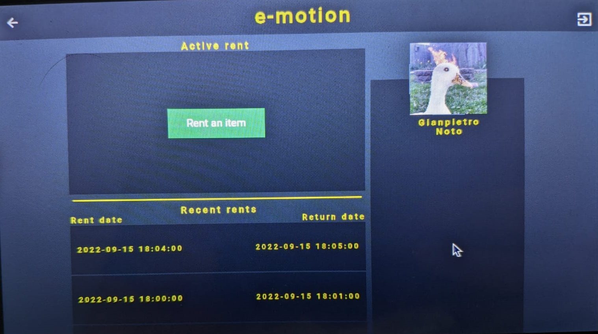
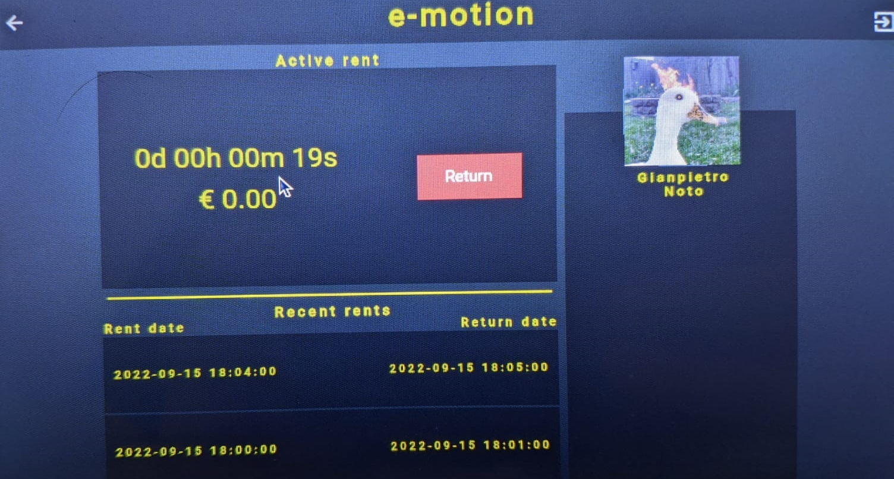
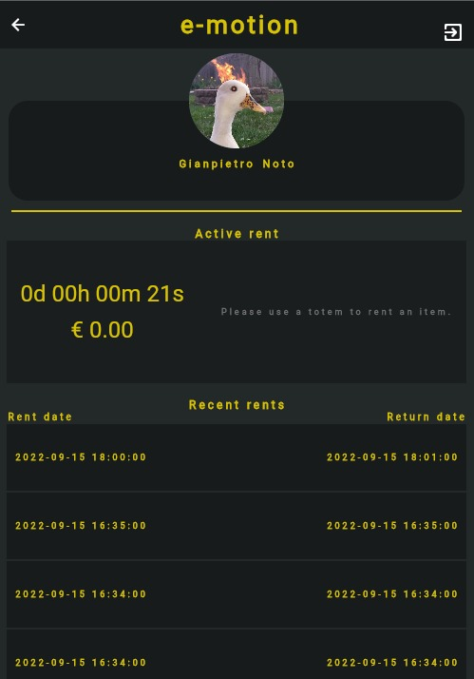
The Totem
When an User login he can rent or return an item, it is shown
the active rent in time and costs.
When the start rent button is pressed, a timer starts and the green button becomes red with text «return».
7

Slide 8
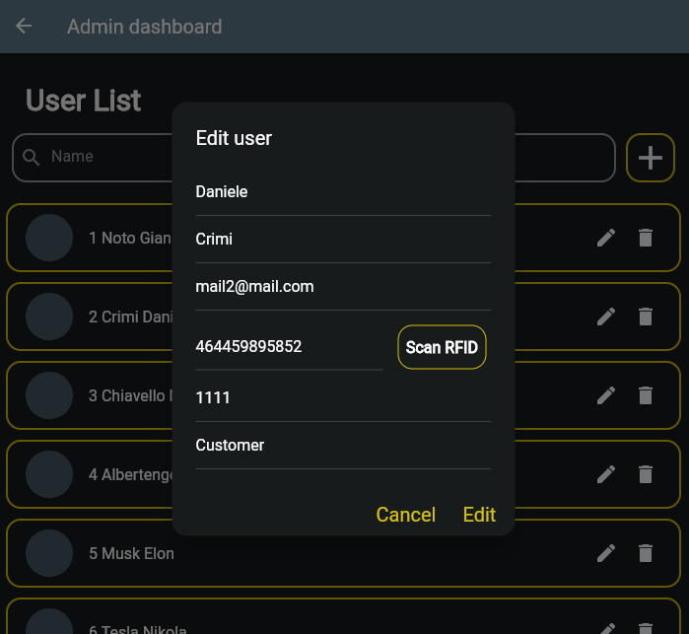
The WEB UI
Have been developed different Web UI to reach the maximum flexibility, so that:
The Admin can play any role of the customers and Users but has the privilege to add/remove Them;
The customers can keep track of the items and Users and can also add/remove/edit them;
The Users can only login to visualize the active rents and the recent history rent.
👨🏻‍💻
👨🏻‍💼
🙋🏻
8

Slide 9
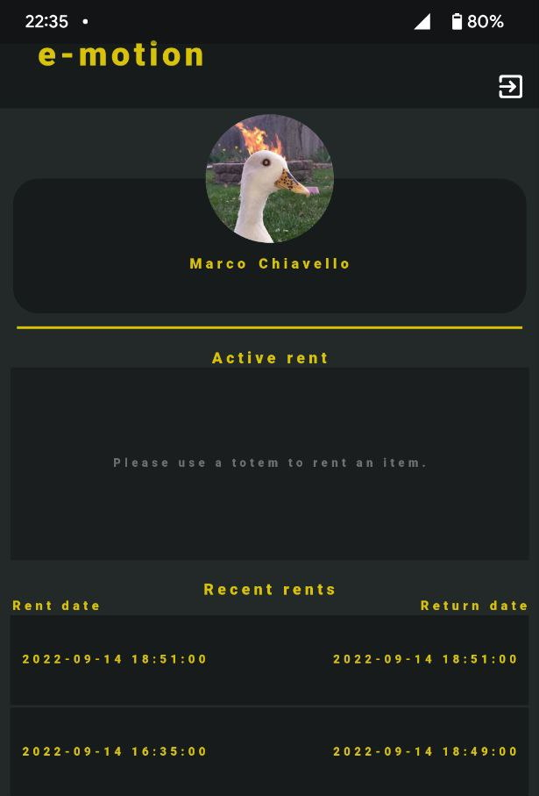

Portability on smartphone
Smartphone Android APP
The Smartphone can be used to keep track of active rents and rent history after the User’s login
It also provides an ADMIN UI and a CUSTOMER UI used to add/remove/edit Users/items
9

Slide 10




Thanks for your attention!
Marco Chiavello s281692
Daniele Crimi s290164
Gianpietro Noto s281305

